Slide 1
ChargeShare Transforming homeowners into charging station entrepreneurs
By Team : GatewayTimeout

Slide 2
Team Members:
Ananthapadmanabhan V
Ashwin T Saji
Adithyan A S

Slide 3
01
The Problem Statement
Public charging stations are frequently occupied, broken, or unreliable
Apartment dwellers and renters cannot install personal home chargers
Limited charging options in residential neighborhoods where people actually live
Long wait times and range anxiety due to insufficient charging network density

Slide 4
PROBLEM FACED BY TARGET USERS
The Problem This Idea Solves:
For EV Owners:
Public charging stations are often occupied or broken
Apartment dwellers can't install personal chargers
Need charging options in residential areas
Want cheaper alternatives to commercial stations
For Homeowners:
EV charger investment sitting unused 20+ hours daily
Could earn passive income from existing infrastructure
Help community while making money

Slide 5
HOW THE IDEA SOLVES THE PROBLEM
Transforms thousands of homes into charging stations
Rapid Scaling: Can deploy 100+ stations in months vs. years for traditional infrastructure
Residential Penetration: Places charging exactly where people live and park overnight
Investment Model: Removes capital burden from single entities - spreads across many homeowners

Slide 6
FEATURES OF THE PRODUCT
Transforming suitable households into charging stations.
Help set up Home
Charging Stations
Navigation feature
Provides navigation to the household charging stations

Slide 7
FEATURES OF THE PRODUCT
Dynamic Pricing Engine
AI-Powered Property Assessment
Automated location scoring analyzes factors (traffic, demographics, competition) to predict charging station profitability and ROI for homeowners.
Revenue Sharing Model
Real-time AI adjusts charging prices based on demand, competition, weather, and local events to maximize host earnings and station utilization.
Hosts earn 45-55% of charging revenue while ChargeFranchise manages operations and takes 15-25% platform commission.

Slide 8
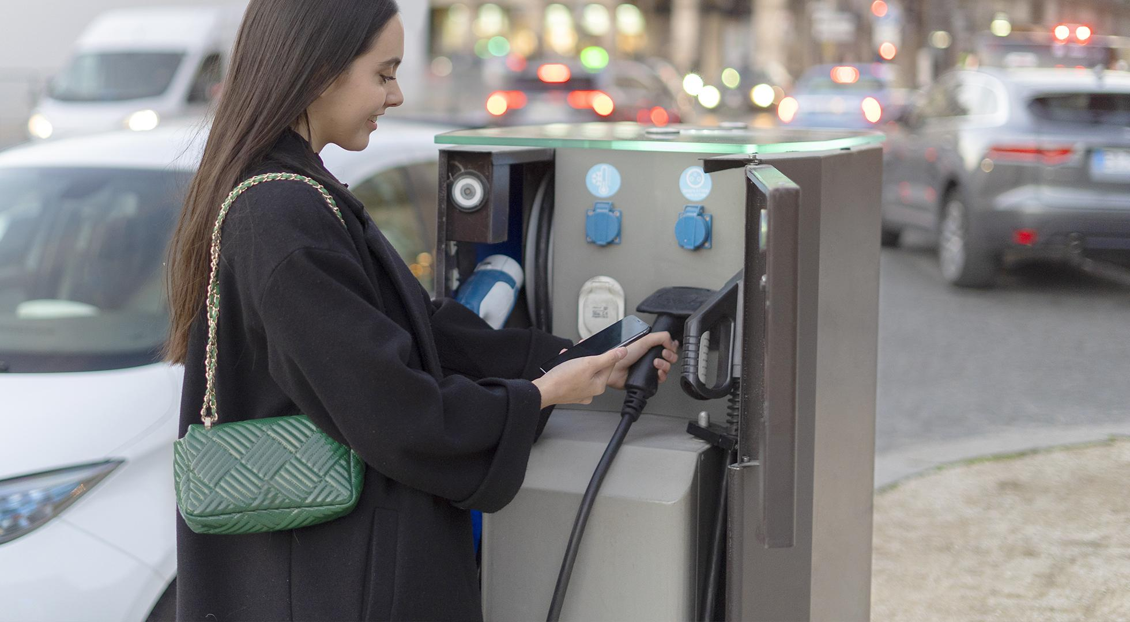
“CONNECTING EV OWNERS WITH HOMEOWNERS WHO HAVE CHARGERS”

Slide 9
MARKET OPPORTUNITIES
GOVERNMENT SUPPORT:
MASSIVE INFRASTRUCTURE GAP:
₹10,000 crore FAME II scheme, state EV policies, and 5% GST on charging equipment create favorable regulatory environment for rapid scaling.
India needs 2.9 million charging stations by 2030 but has only 12,000 today - a 240x growth requirement creating urgent market need.

Slide 10
BUSINESS MODEL
How will we make money?
INVESTMENT PARTNERSHIP
TRANSACTION COMMISSION
Partner with EV charging infrastructure development companies like Tata Power,ABB India etc. on charging station installations, taking 40-50% of ongoing charging revenue while providing platform services.
Take 15-20% commission on every charging session booked through the platform, generating revenue from the growing volume of EV charging transactions.

Slide 11
ESTIMATED COST
Host Investment Tiers: Individual charging stations require ₹2-3 lakhs for basic setups (1-2 ports), ₹5-7 lakhs for premium installations (3-4 ports with AC/DC mix), and ₹10+ lakhs for full charging hubs with 6+ ports and fast DC charging capability.
Platform Development Costs: Building the complete tech stack (React Native app, Node.js backend, AI pricing engine, IoT integration, payment systems) would require approximately ₹50-75 lakhs for initial development and deployment across major cities

Slide 12
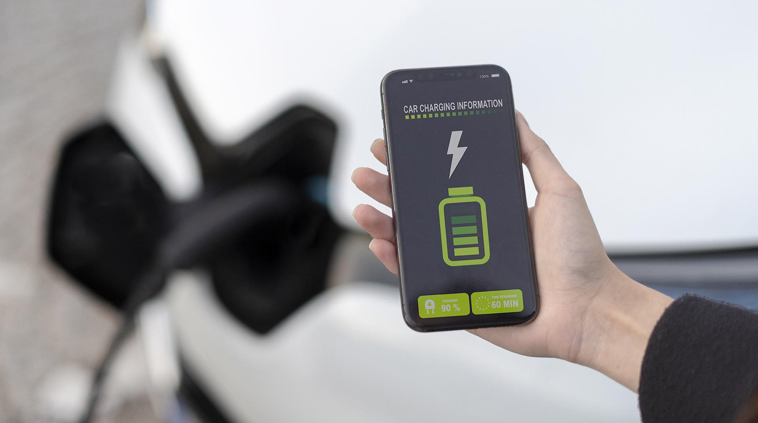
SCALING POTENTIAL
Scaling Potential: ChargeShare can scale from 500 charging points in Delhi NCR (₹8.75M monthly revenue) to 50,000+ points nationwide within 3 years
Key Integrations: The platform can integrate with vehicle OEMs (Tata, Mahindra, MG) for seamless in-car charging recommendations, partner with real estate giants (DLF, Godrej) for new project installations.

Slide 13
45,300,000
By 2030,EV users are expected to rise to

Slide 14



OUR TEAM
Ashwin T Saji
Ananthapadmanabhan V
Adithyan A S
S3 CSE
S3 CSE
S3 CSE
Ph No: 9074887851
Ph No: 8075648240
Ph No:9539367024

Slide 15
THANK YOU!
Any Questions?

